Slide 1
615 Final Project presentation
Ecommerce Retail Data Analysis
By Qianhui Rong

Slide 2
Contents
Data Preprocess
Data Validity Analysis
EDA on Time
EDA on Country
Text Analysis on Item Descriptions
Marketing Analysis
Linear Model

Slide 3
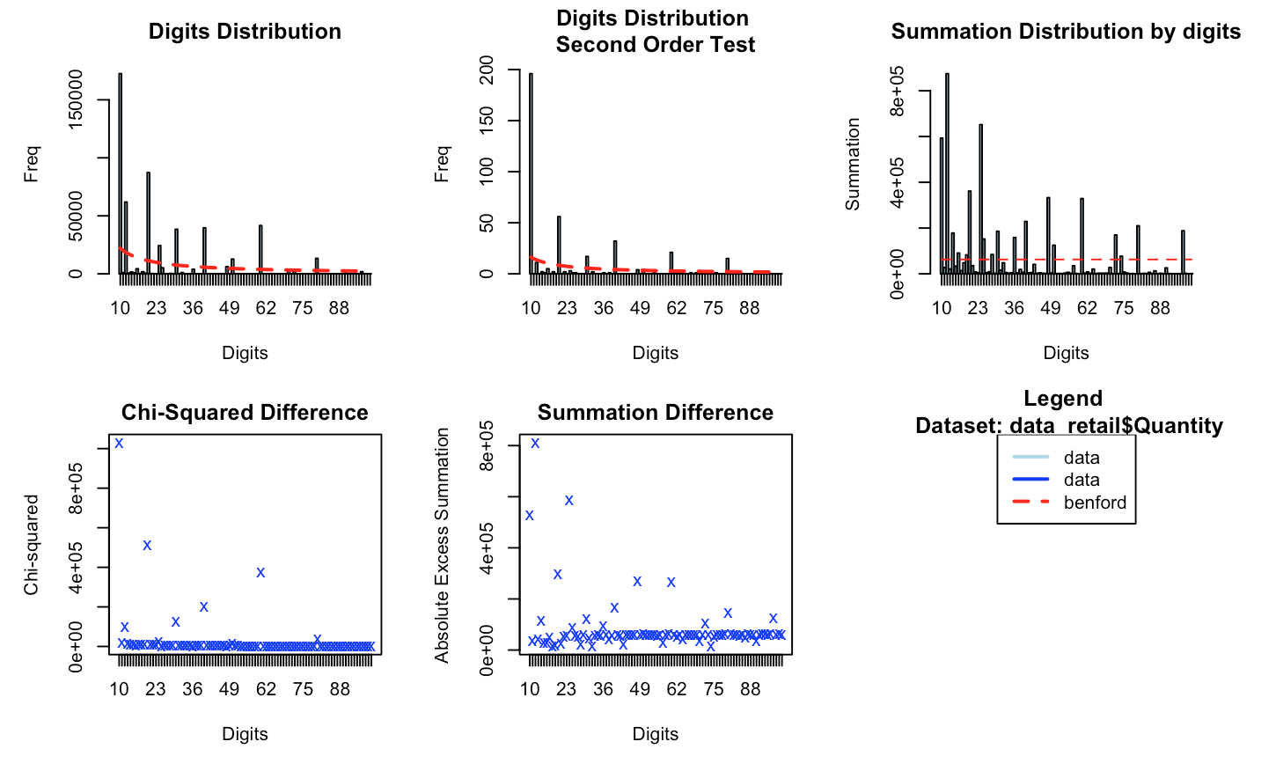
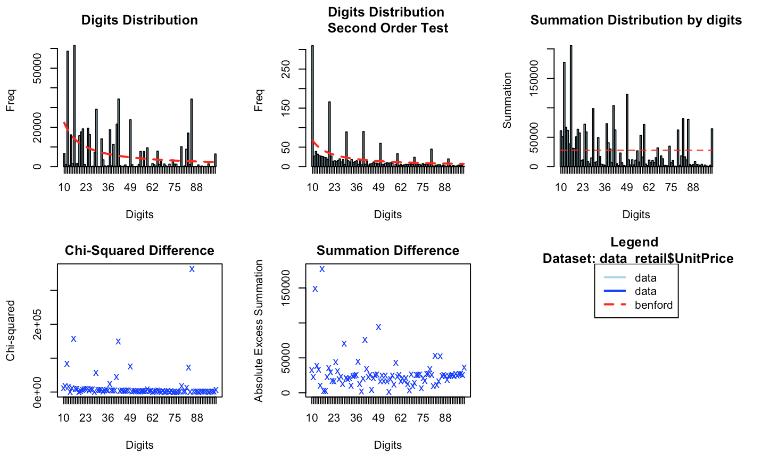
Data Validity Analysis
Benford Law Analysis Plots
From both Benford plots and chi-square test, we can see that unit price and quantity don't follow Benford Distribution and the difference is large.
Move on to check distributions of Unit Price and Quantity to see if they follow the ones I've expected.

Slide 4
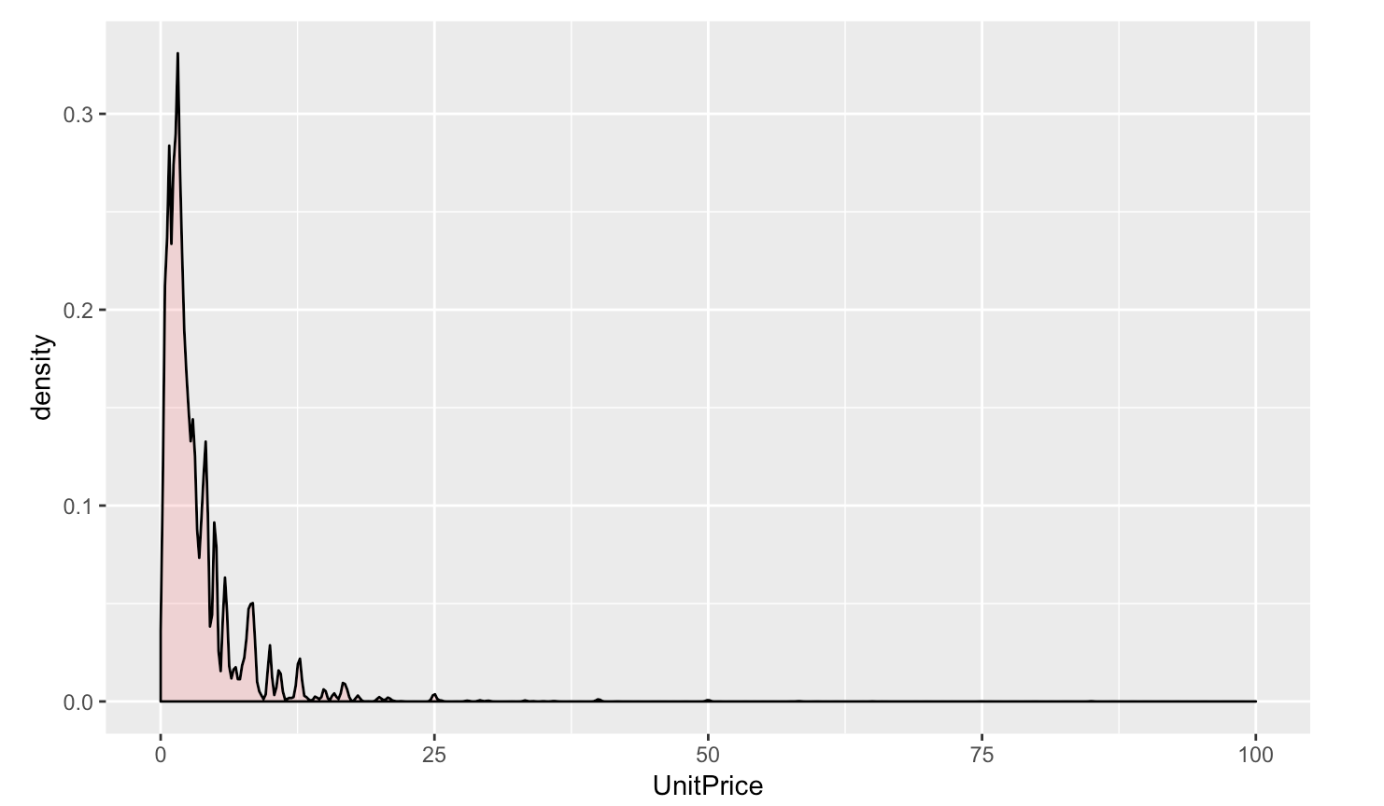
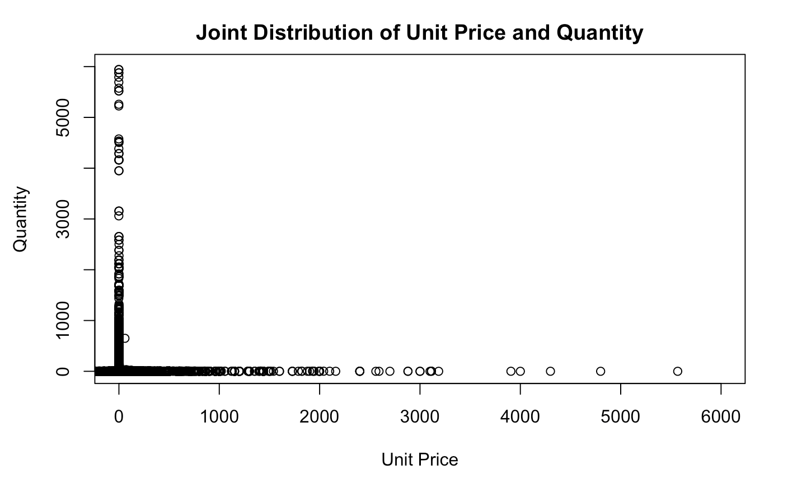
For Unit Price: I expect a larger amount at lower price (ex. 0 ~ 10 dollars) and a smaller amount at higher price;
From the plot : Almost all data are located between 0~20 dollar. This distribution plot seems like a Laplace Distribution's right side with a drastical decay rate.
For Quantity: I expect a larger amount for cheaper price items and a smaller amount for more expensive items;
From the plot : Around zero the purchase quantity is really high, and as the price increases, the quantity decrease(sharply). We can say that the purchase quantity of items priced around zero can not be compared with those higher than zero to the same scale.

Slide 5
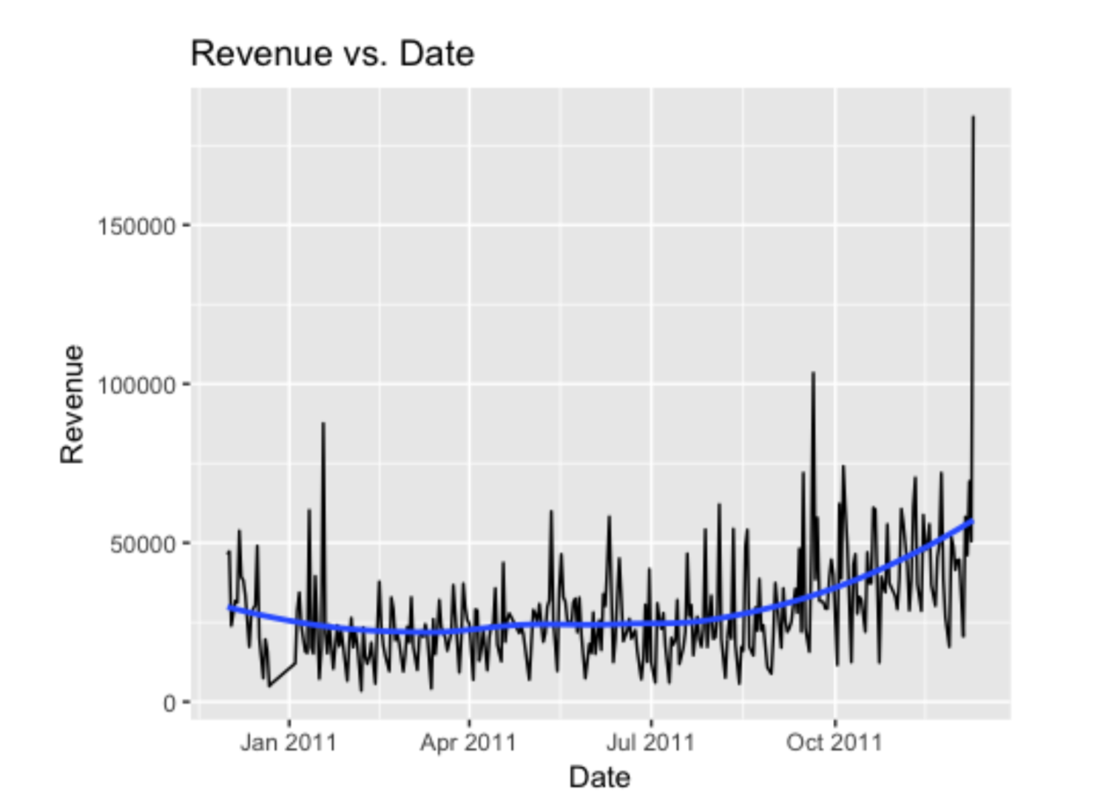
EDA on Time
This plot shows an increasing trend starting from Sept.2011.

Slide 6
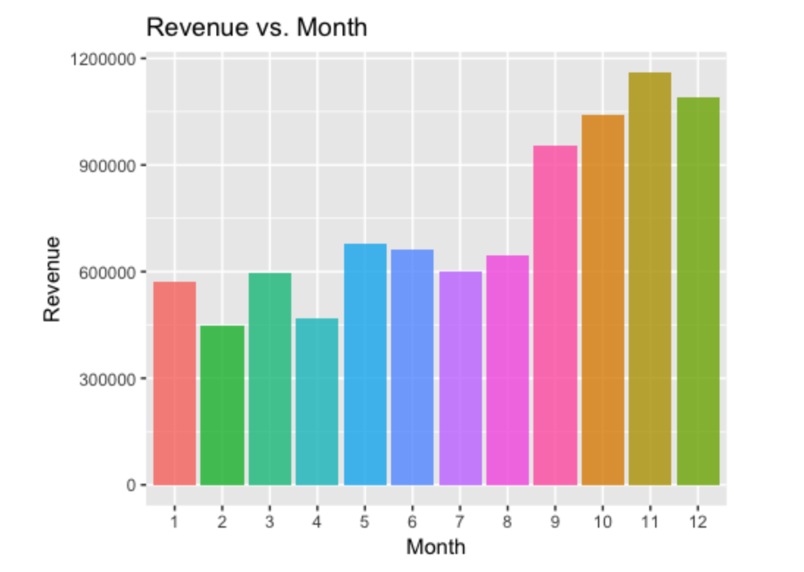
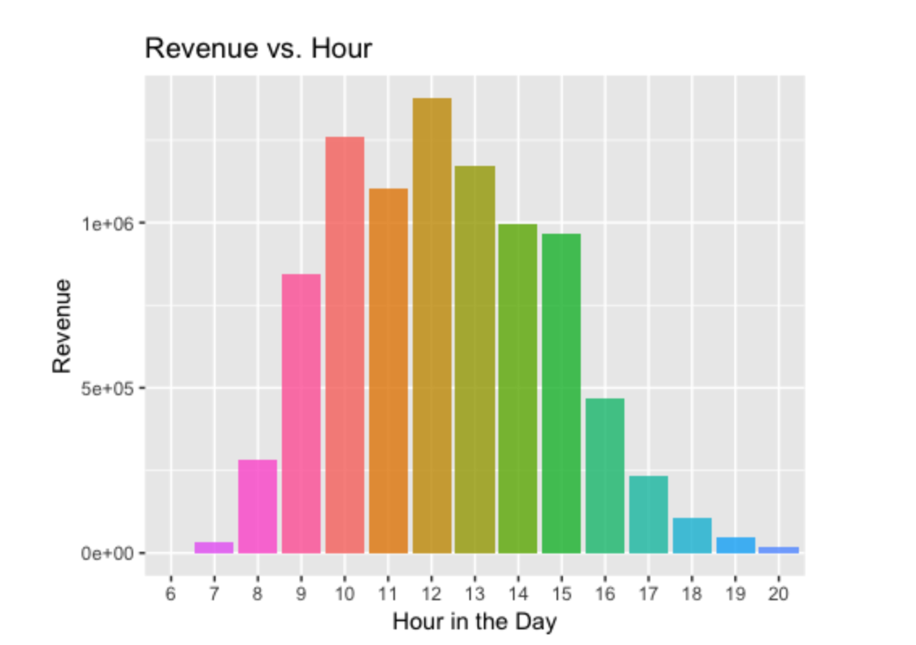
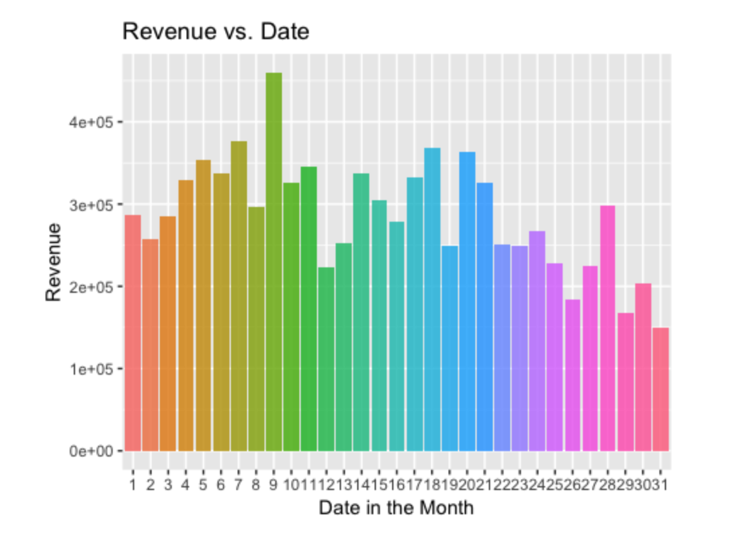
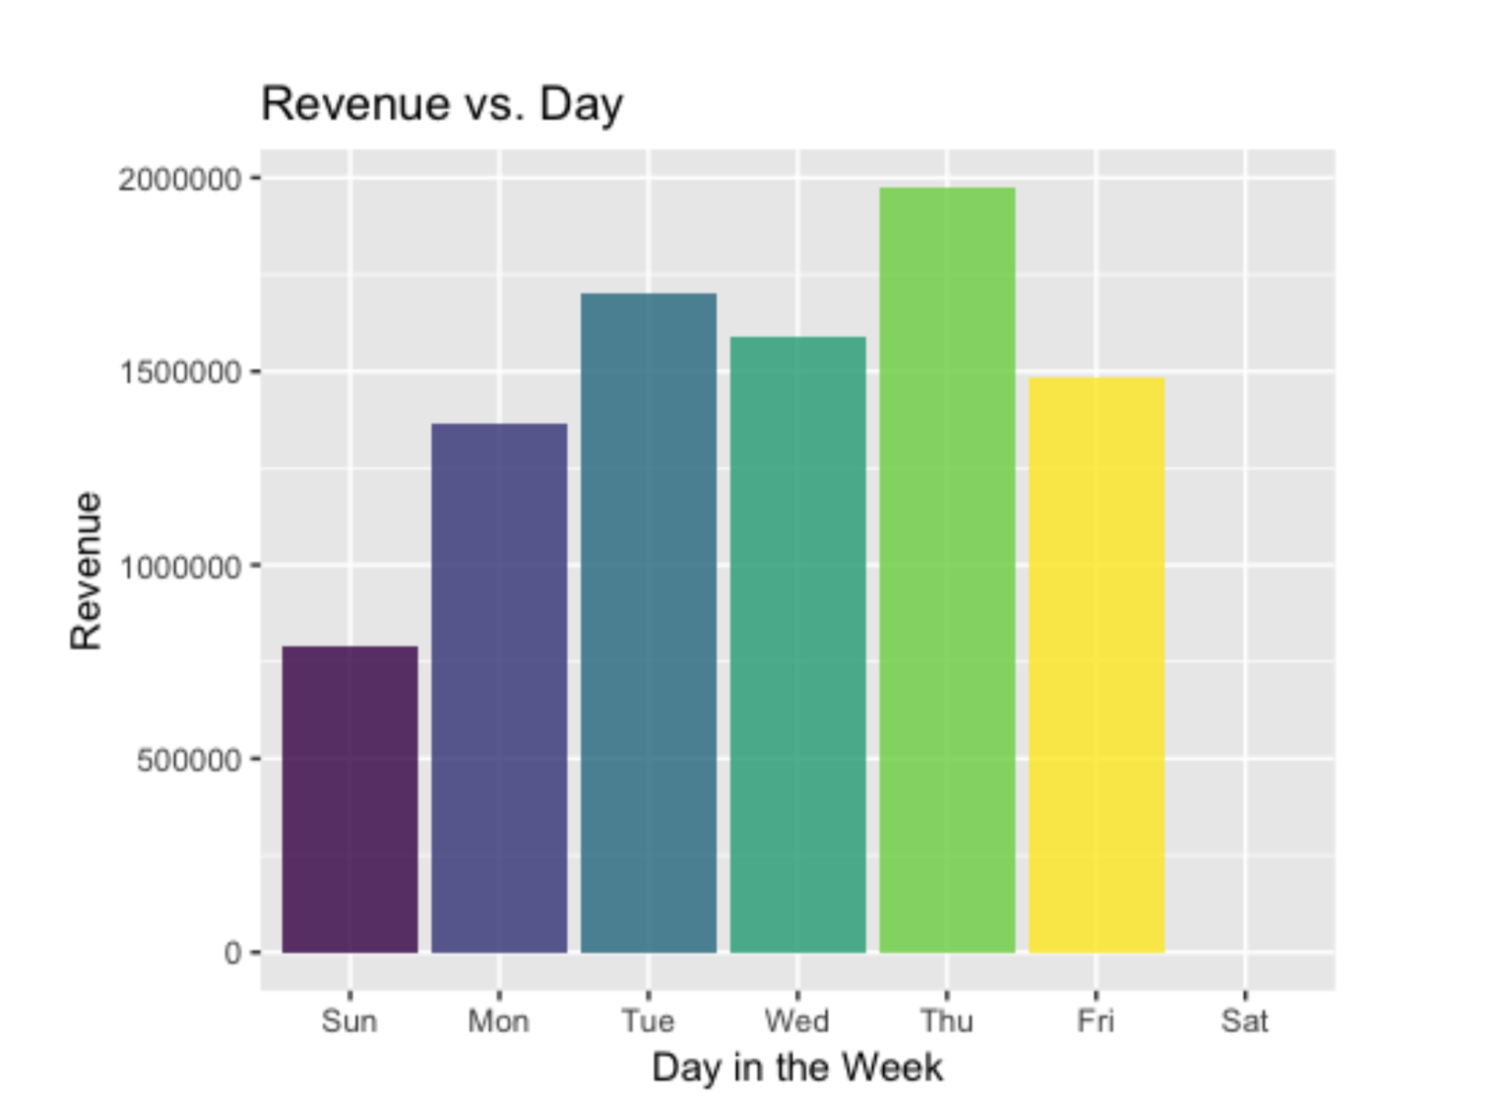

Slide 7
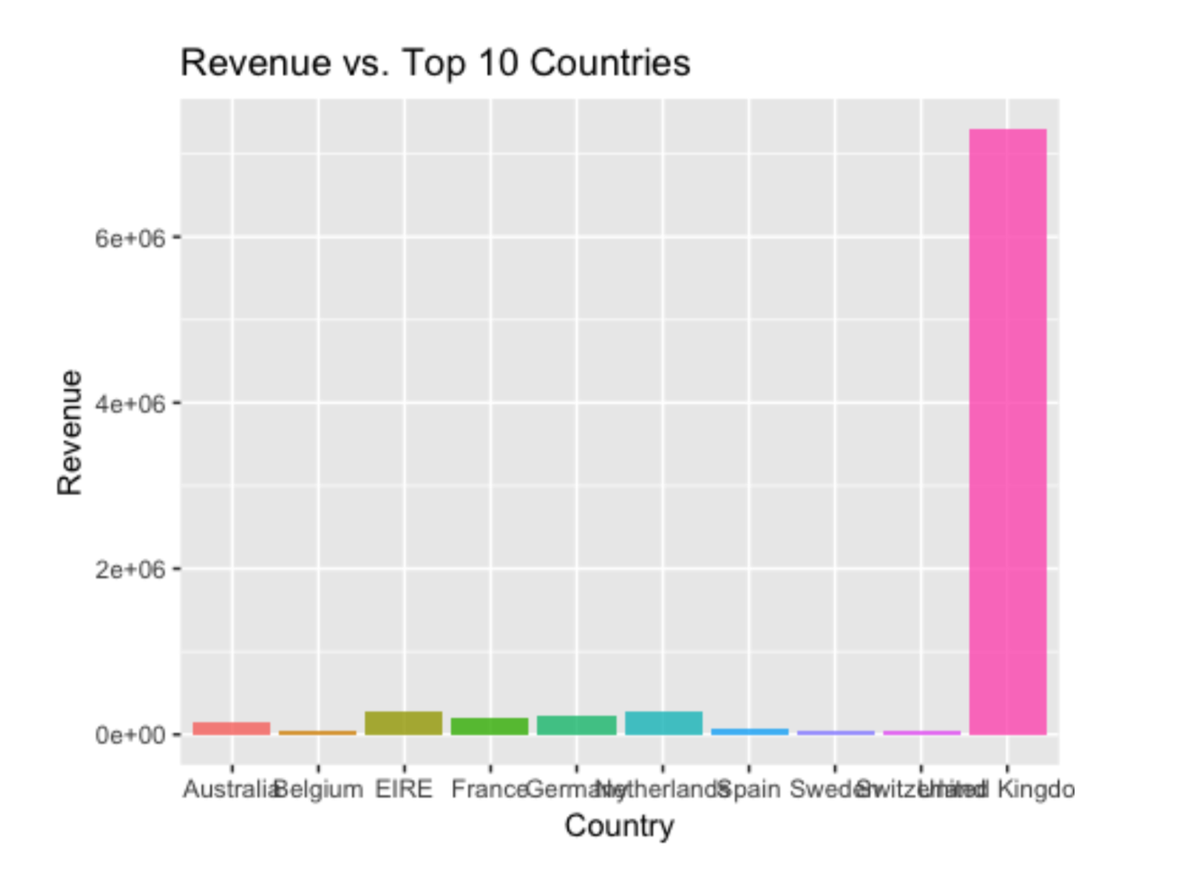
EDA On country
UK is having an absolute dominant place.

Slide 8
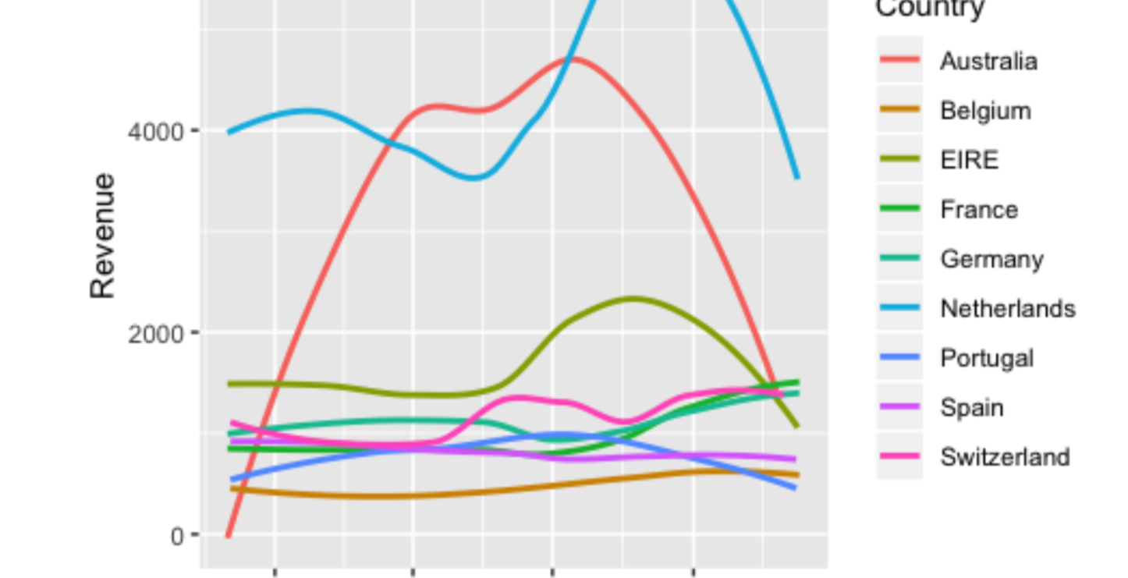
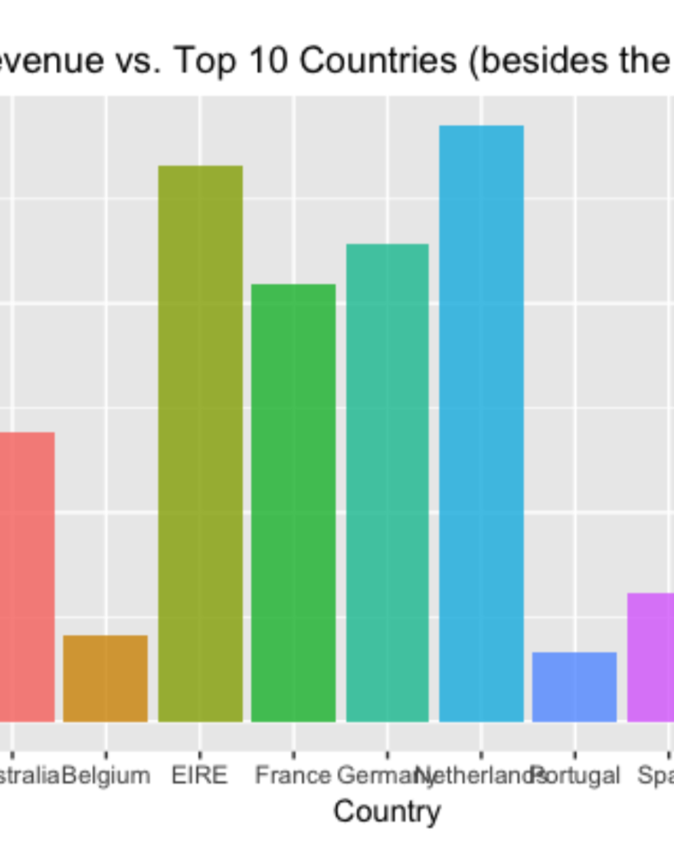
EDA On country (Continued)

Slide 9
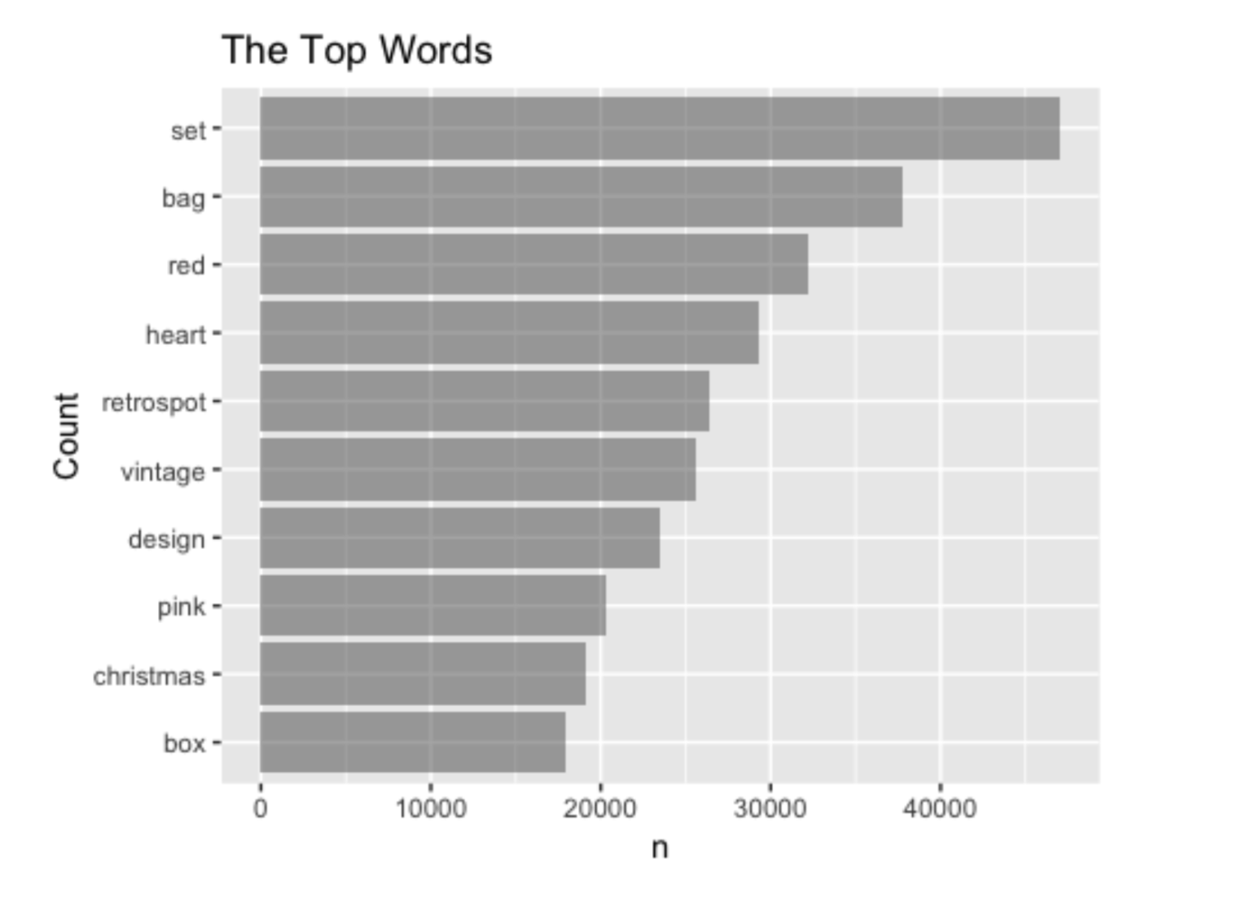

Text Analysis on Item Descriptions

Slide 10

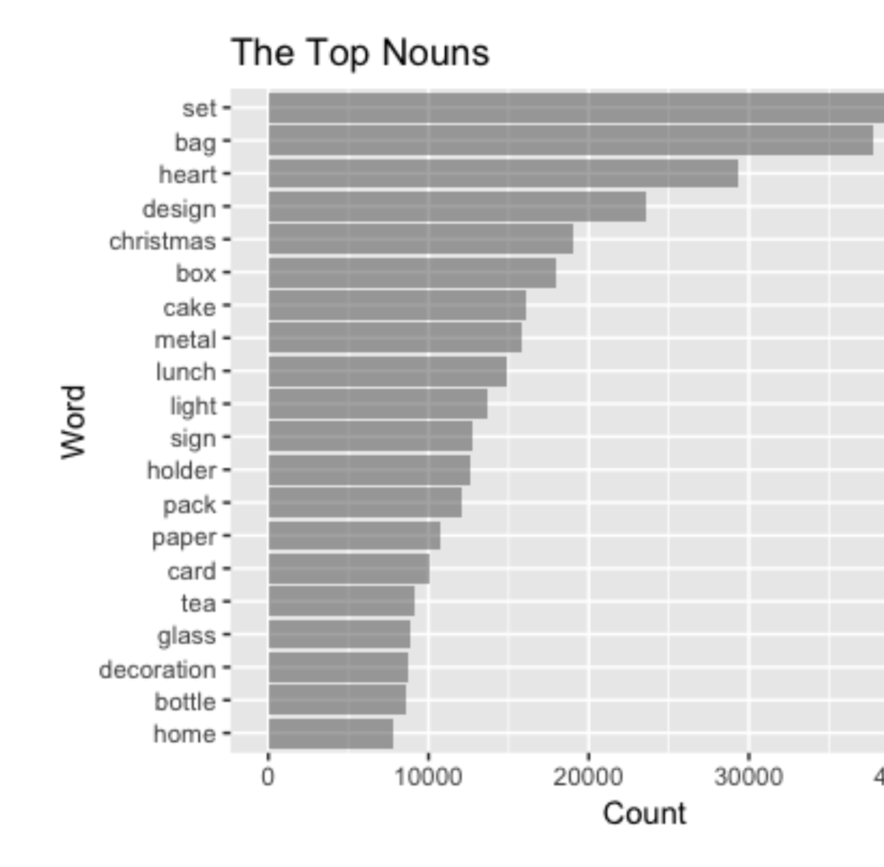
Top Nouns in item descriptions

Slide 11
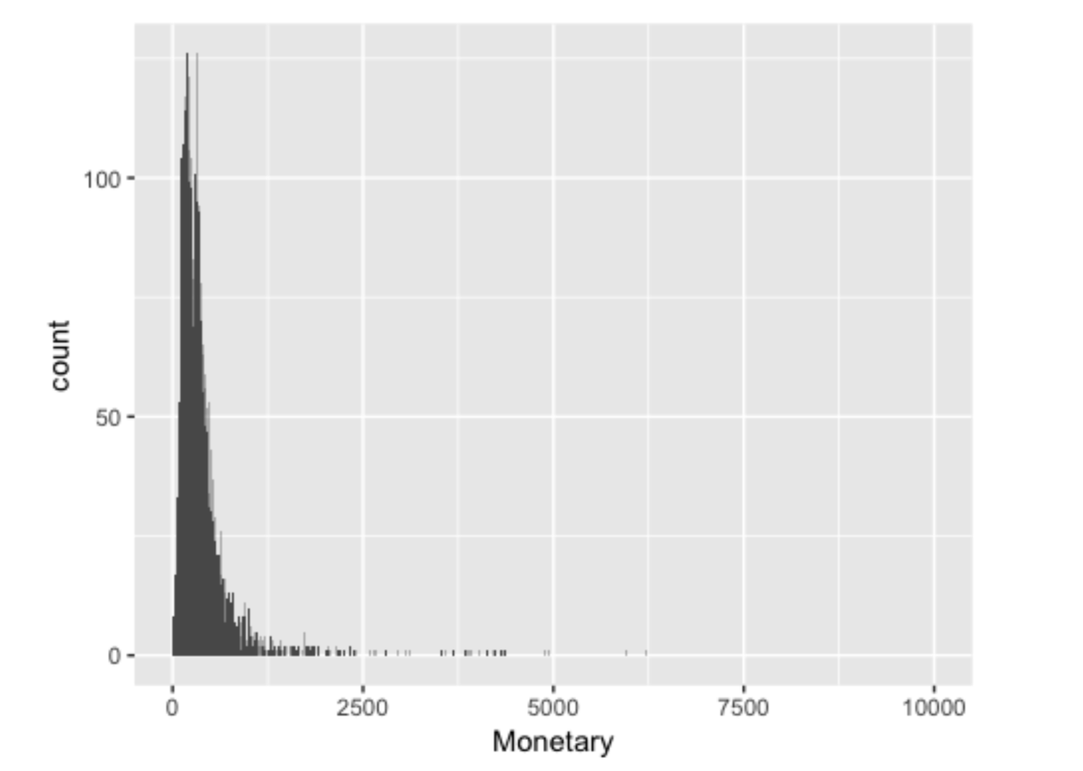
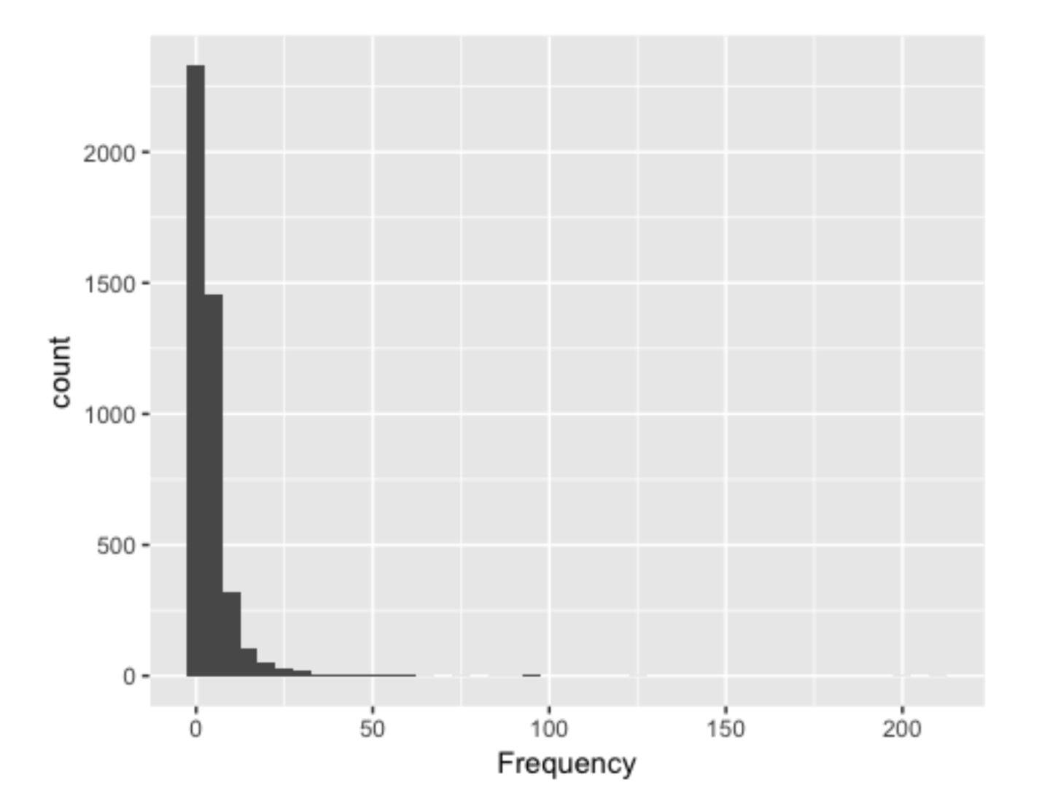
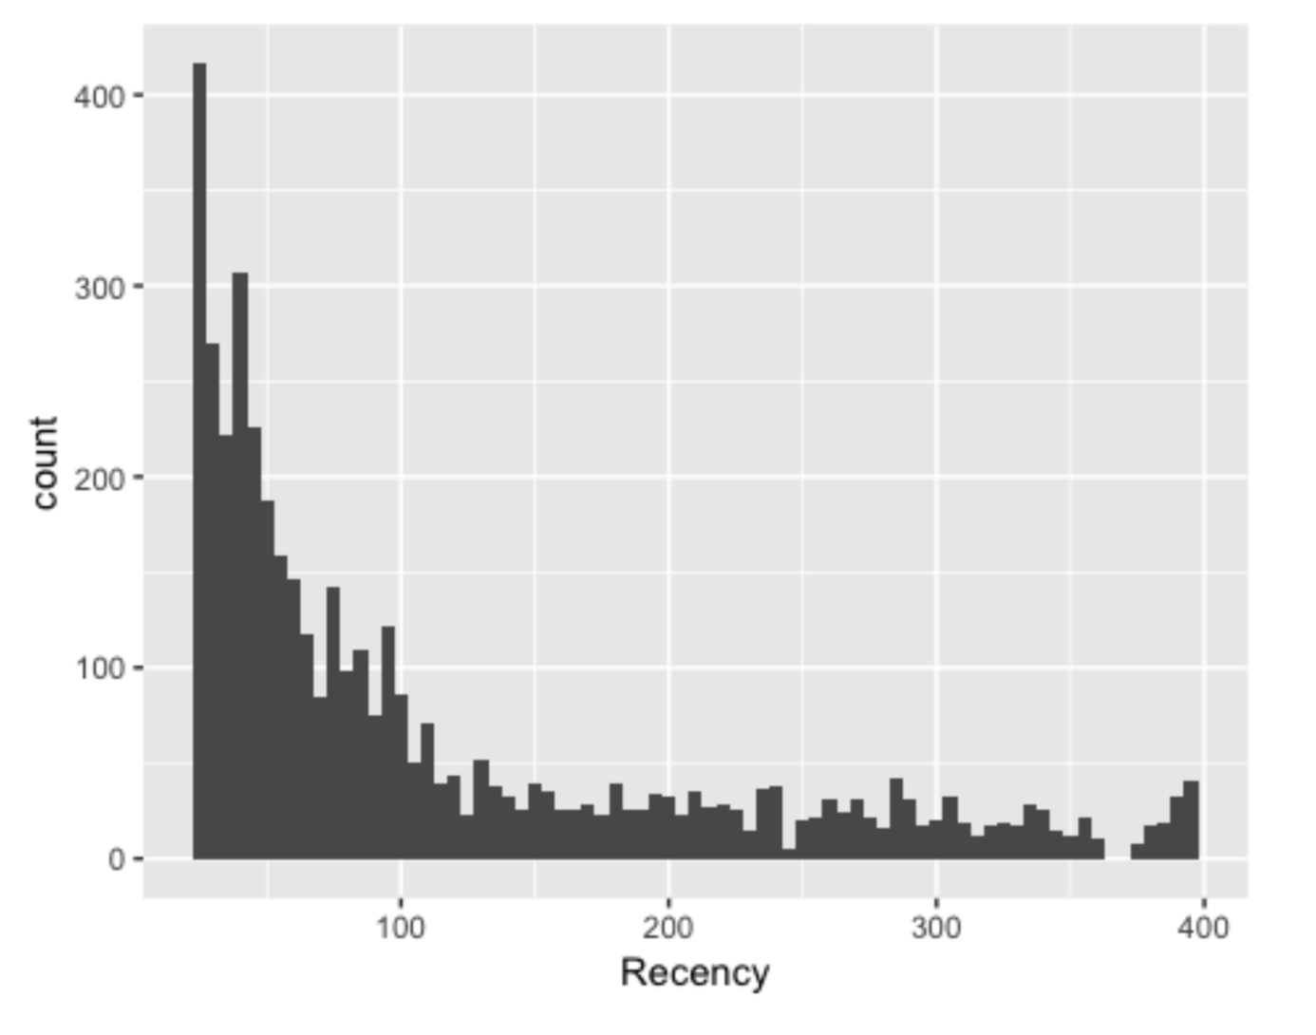
Marketing analysis – RFM Analysis
RFM
Recency: how recent a customer has purchased
Frequency: how often they purchase
Monetary: how much the customer spends

Slide 12
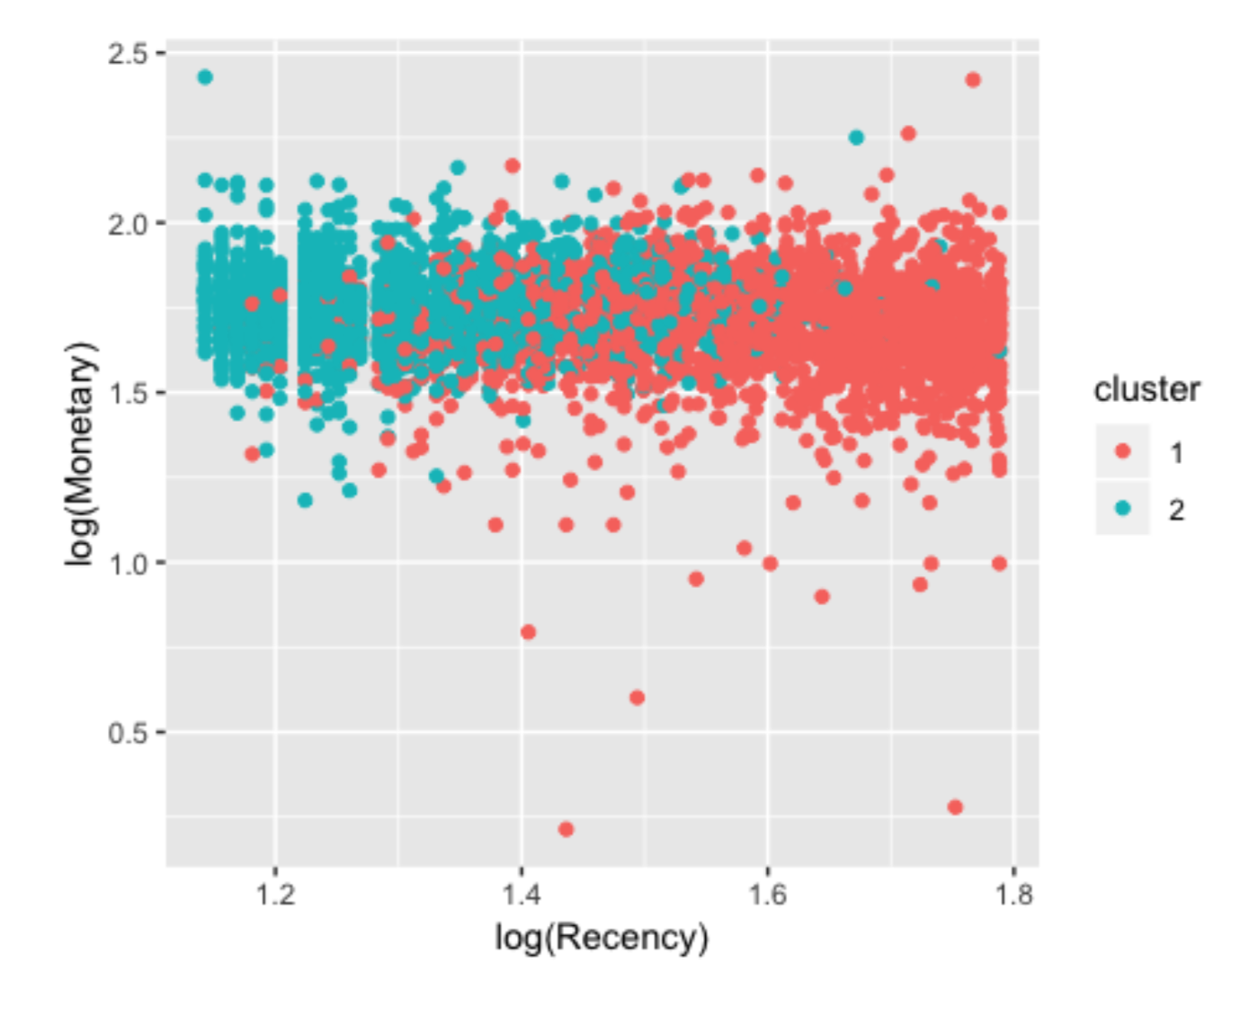
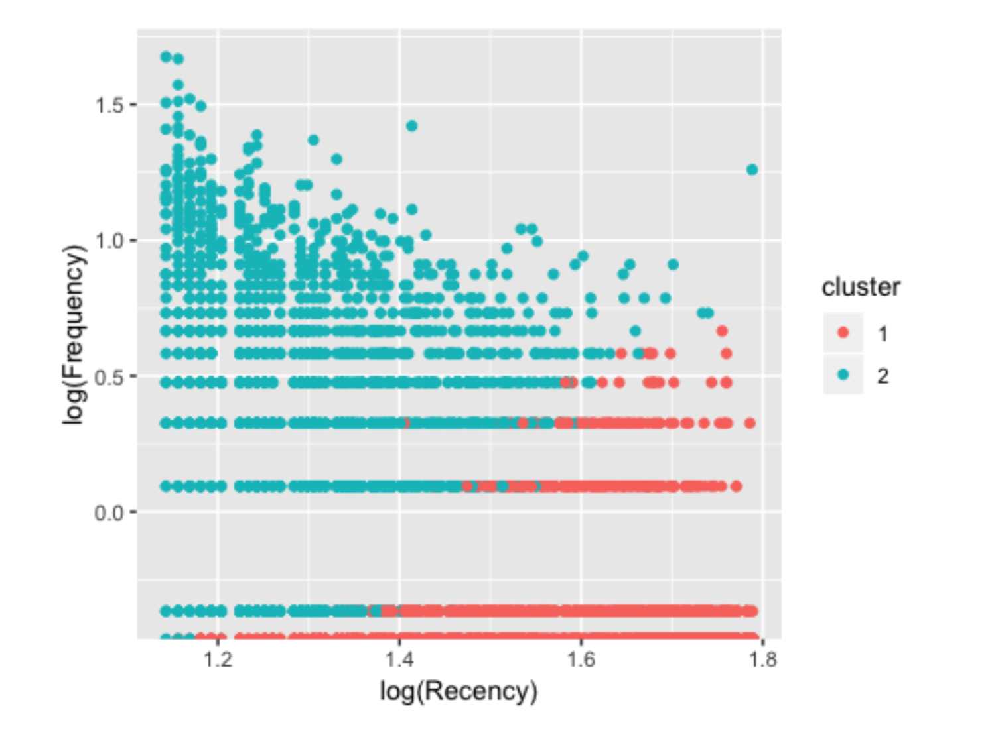
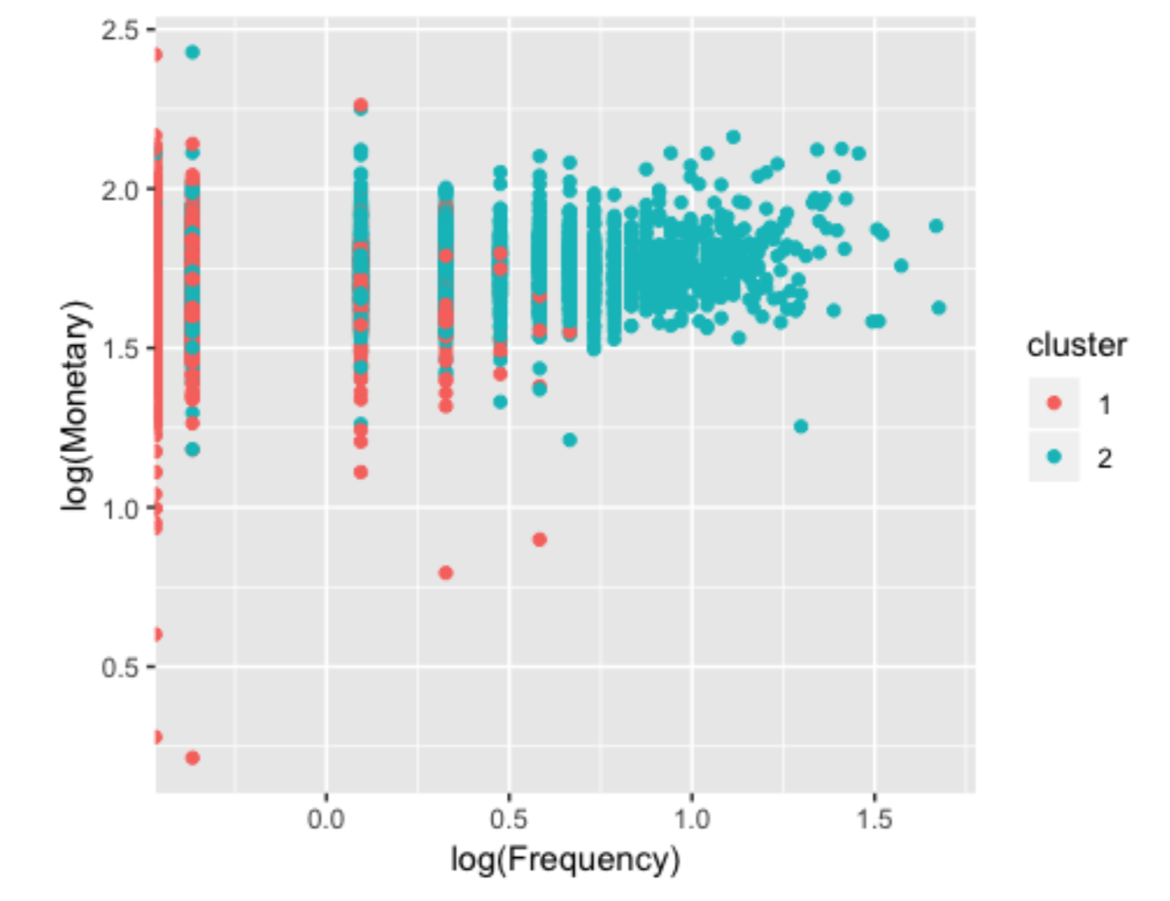
Marketing analysis – Clustering
With KMEANS

Slide 13

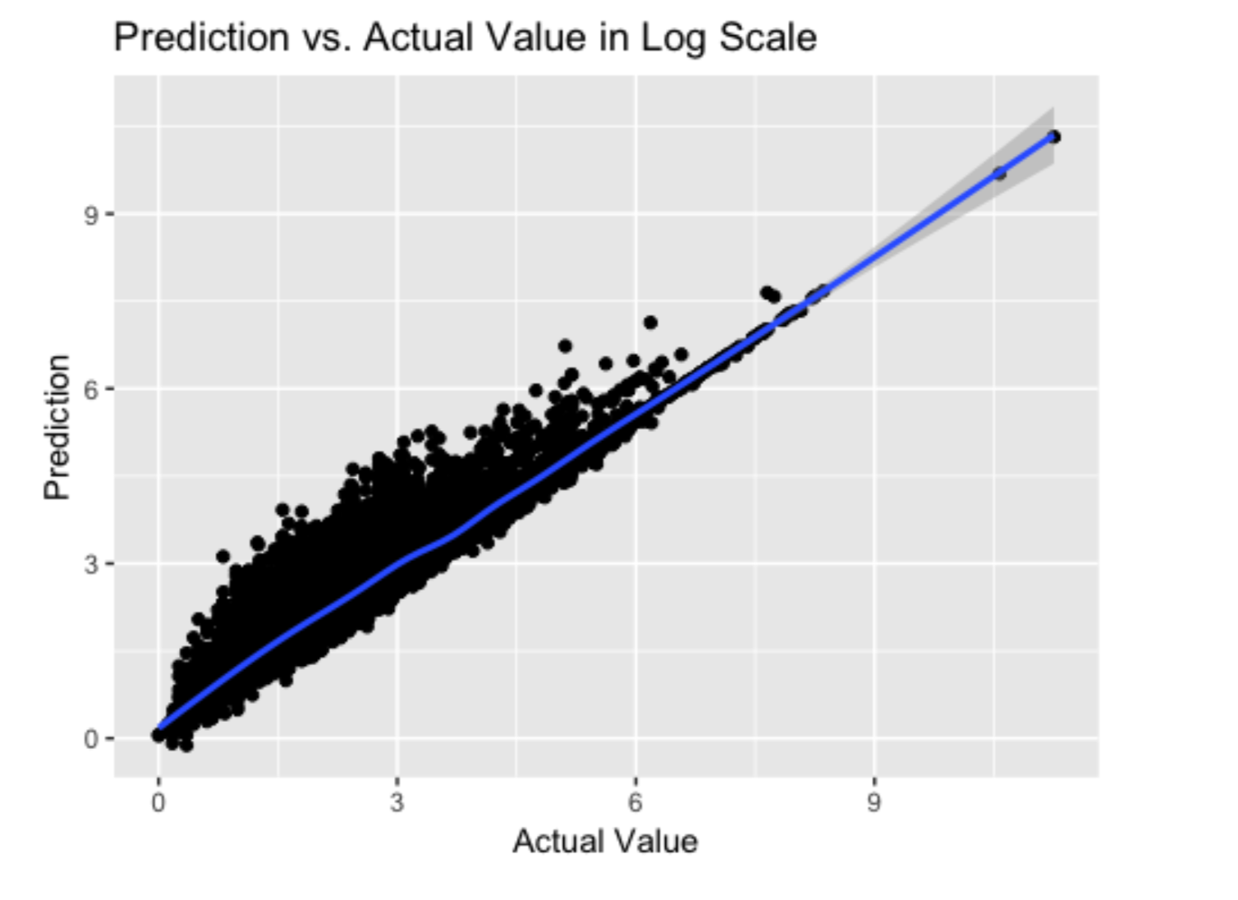
Linear Model
A classic linear model to explain the total spend for each customer, with their RFM values.
This model is fairly good at first look, with a high R-square value.
But as for residual plot, a clear pattern is shown.

